Slide 1
Sean Koppenhafer, Jaime Rodriguez,
Chad Thueson, Noah Erickson, Rishal Dass
Weekly meeting, 05/27/2015
Digital Dash
Portland State University
Department of Electrical and Computer Engineering (ECE)
Notes:
1
1

Slide 2
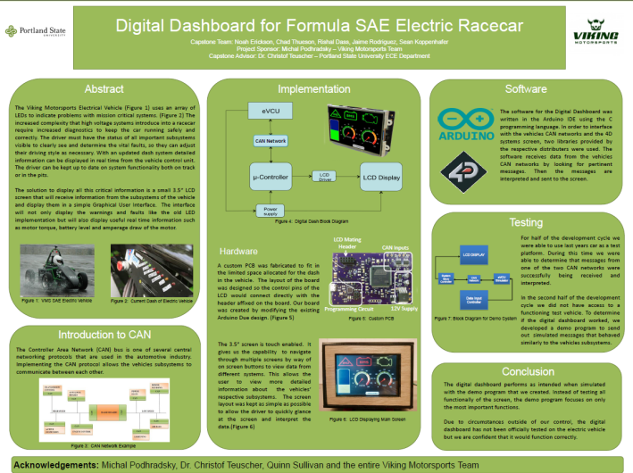
Report and Poster
Poster has been completed
The majority of the report has been written. Need to add finishing touches.

Slide 3
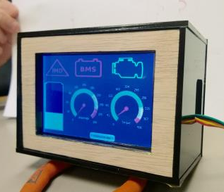
Enclosure Implementation
Michal wants the enclosure to be flushed
Final enclosure, had an outer box and a inner box
Makes it more water resistance
Outer box adds a cowl for the screen
With flush mount, the final enclosure will not fit
Will only fit with the inner box
This makes it less water resistance
No more cowl for the screen

Slide 4
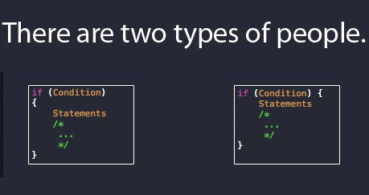
Final Code/Demo Code
Final Code
Screen has been locking/freezing up
Only a certain amount of data can be sent into each CAN bus when using interrupt method
Solution
Michal uses pulling method
Ask Michal to change his code to send some data from CAN0 to CAN1
Michal’s response
Change our entire code to pulling method
Rewrite his entire code ourselves

Slide 5
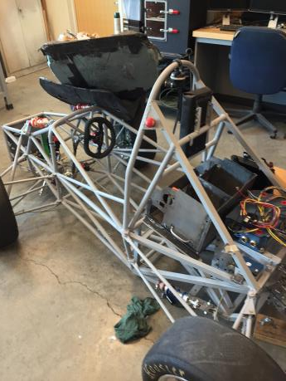
Electric Vehicle Update
In Progress?
Team seems hopeful that it will be put back together by this Friday
We will need to implement the whole system into the car this Friday
Picture taken: 5/26/2015

Slide 6

Goals For The Upcoming Week
System
- Stop the system from freezing up
- Debug (if any) system implementation to the car
Documentation/Report
- Keep working on report
- Finalize wiki, check if it suits Michal’s requirements.
Other
- Presentation of the final system to the VMS team.
Notes:
6

